Slide 1


Infosys Springboard Internship 5.0
Voice Based Patient Call System
MENTOR- Shilpie Mam

Slide 2






Why is a Voice-Based Patient Call System Needed?
Faster Response to Emergencies
Hands-Free and Accessible Communication
Reducing Nurse Workload and Burnout
Improved Hospital Workflow
Voice-activated alerts enable rapid response, ensuring immediate attention during critical situations.
Streamlines operations, optimizing staff coordination and resource allocation.
Offers easy, hands-free communication, particularly beneficial for patients with mobility challenges.
Automates routine tasks, alleviating the burden on nurses and reducing burnout.
Integration with Smart Healthcare Systems
Enhanced Patient Experience and Satisfaction
Connects effortlessly with existing hospital technologies, creating a unified smart environment.
Increases patient comfort and satisfaction through user-friendly and responsive communication.

Slide 3





Problem Statement
Delayed Nurse Response
Patients often experience delays in getting assistance due to manual call systems.
Lack of Prioritization
Current systems do not differentiate between urgent and non-urgent requests, resulting in inefficient resource utilization
Limited Communication Channels
Patients typically rely on a single-button system that lacks clarity and context about their needs
Inconsistent Monitoring
Administrators have limited visibility into response times and nurse workload, making it harder to track service quality

Slide 4





Proposed Solution
Voice-Based Patient Requests
Patients can initiate requests using natural language through a voice-enabled interface
AI-Driven Prioritization
An AI engine classifies requests based on urgency (e.g., emergency, assistance, or routine).
Real-Time Mobile Notifications
Nurses receive real-time notifications with detailed information about the patient's request.
Inconsistent Monitoring
Administrators have limited visibility into response times and nurse workload, making it harder to track service quality

Slide 5







System Workflow
Patient Request
The patient speaks into the device to make a request (e.g., "I need water" or "I feel pain").
Speech Recognition
The request is converted from voice to text using Gemini Speech Services
Natural Language Processing
The system processes the request using NLP to extract intent and context
Priority Assignment
AI assigns a priority level to the request (Critical, Important, Normal).
Backend Processing
The backend server handles the request, stores it in the database, and sends it to the appropriate nurse.
Real-Time Notification
Nurses receive notifications on their mobile app with request details and priority.
Response and Status Update
The nurse attends to the request and updates the status (Pending, In Progress, Resolved). The update is reflected in real-time across the system.

Slide 6
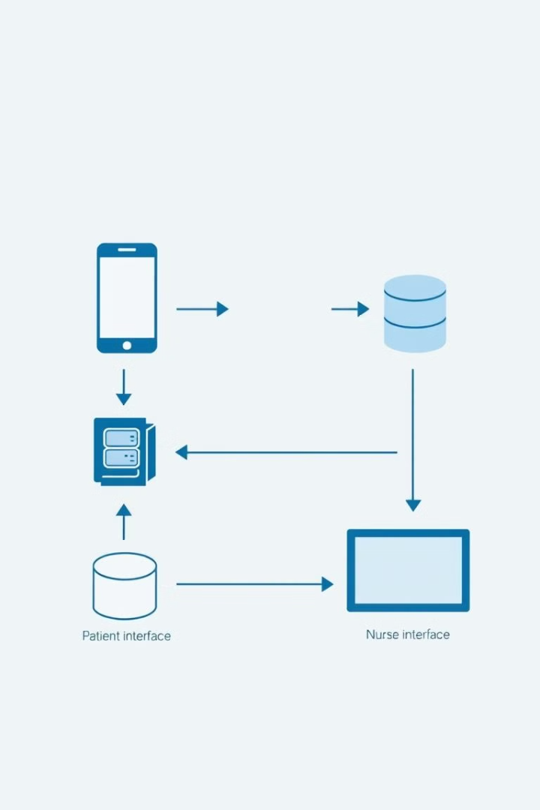




SYSTEM ARCHITECTURE
Patient Interface
Backend Processing
Data Storage
Voice input capture and request initiation
MongoDB for patient and request data
NLP analysis and request routing
Nurse Interface
Real-time notifications and response management

Slide 7
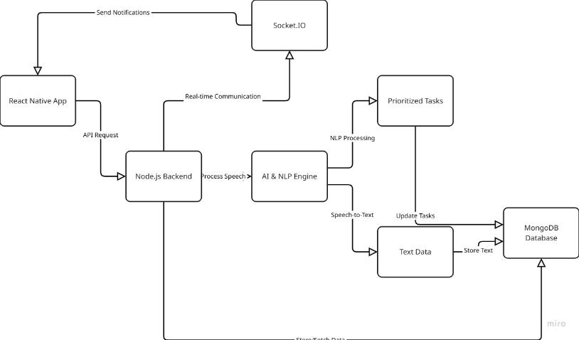
System Interface
The system features intuitive interfaces for patients, nurses, and administrators, ensuring seamless communication and efficient workflow management.

Slide 8





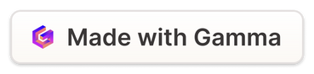
Key Features
Voice-Based Interface
AI & NLP Processing
Role-Based Access
Patients use voice for assistance, simplifying interactions.
AI interprets requests, assigning priority levels.
Different interfaces for patients, nurses, and admins.
Real-Time Communication
Instant updates via Socket.IO keep nurses informed.

Slide 9



Role-Based System Access
Nurses
Patients
Admins
Access prioritized requests and provide real-time status updates to patients.
Easily register and initiate requests with voice commands, viewing real-time status updates.
Maintain comprehensive system control with user management and activity monitoring tools.
The system provides tailored access and features for nurses, patients, and administrators to ensure seamless and efficient operation.

Slide 10
Technology Stack
Backend Technologies
Frontend Technologies
Node.js: JavaScript runtime for building scalable server-side applications.
React Native: Framework for building cross-platform mobile apps for nurses and patients.
Express.js: A web application framework for handling HTTP requests and routing.
Expo: Provides tools and services for developing, building, and deploying React Native apps.
MongoDB: A NoSQL database for storing unstructured data, ideal for dynamic healthcare data.
Socket.IO Client: Connects the mobile app with the server for real-time communication.
Socket.IO: Enables real-time, bidirectional communication between the server and clients.
JWT (JSON Web Tokens): Ensures secure user authentication and session management.

Slide 11






AI & NLP Functionality
How AI and NLP enhance patient request management.
NLU
Identifies key phrases and cues.
Voice Recognition
Converts voice to text.
Priority Assignment
Classifies requests by urgency.

Slide 12






How Real-Time Communication Works
Explore the system's communication framework, powered by Socket.IO. It facilitates instant updates between the server and client interfaces.
Patient Request
Patient uses voice to initiate a request.
Voice to Text
AI converts speech into text.
Request Processing
The system processes the request and assigns priority.
Nurse Notification
Nurse receives an instant notification with request details.
Status Updates
Nurses provide real-time status updates to patients.

Slide 13



We appreciate your time and attention!
Partnership
Teamwork
Innovation
We value every opportunity to collaborate with you.
Our team is committed to delivering excellence.
We strive to bring cutting-edge solutions to you.

